Slide 1
Differentiated Care for People Aging with HIV
Ms. Patricia Asero Ochieng
Dandora Community AIDS Support Association (DACASA), Kenya

Slide 2
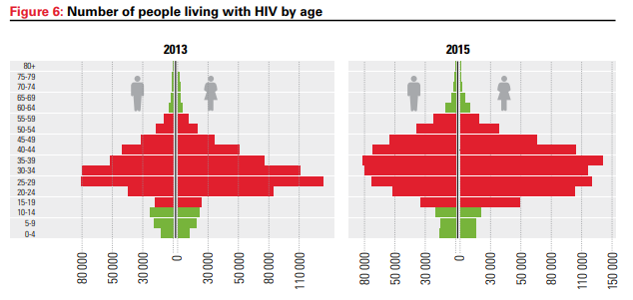
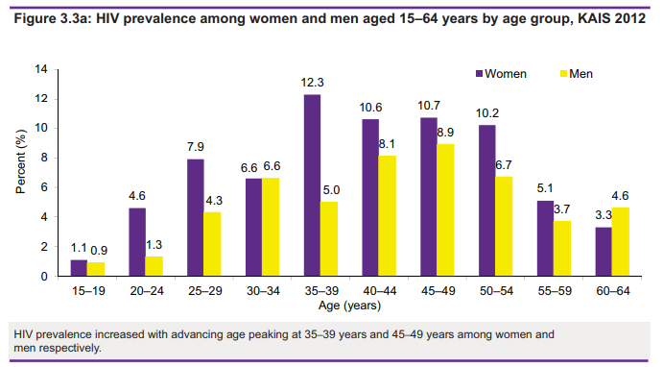
Older PLWH in Kenya
Increasing number of older PLWH as access to ART increases
High HIV prevalence among older age groups
Source: Kenya AIDS Response Progress Report, 2016
Source: Kenya AIDS Indicator Survey, 2012

Slide 3
Why differentiated care?
Access barriers
Co-morbidities
Adherence barriers
Mobility challenges
Co-morbidities due to aging
Limited social support
Financial constraints
Side effects of ART
Drug-drug interactions

Slide 4
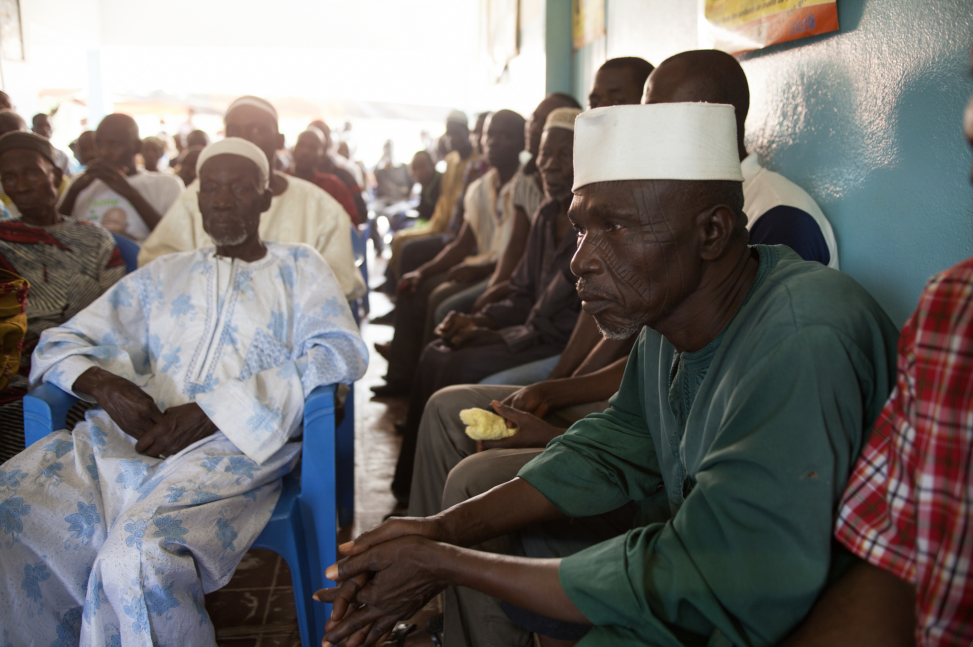
Tailoring DSD to older PLWHA

